Slide 1

An Innovative Approach of Using Blockchain for Custody
Notes:
B-Chain

Slide 2
Custody
Citi 2016
What are we doing?
Truth
Qualified custodian
Holding and servicing of assets on behalf of others
$2.2
B
Core Custody Services
Safekeeping
Settlement
Revenue
Citigroup earned $2.2 billion Custody Banking Fees in 2016 ^{(Trefis Team, 2017)}
Custody Banking Fees
Reference:
Trefis Team. (2017). What Proportion Of Revenues For The 4 Largest Custody Banks Came From Custody Banking Fees In 2016?. Retrieved from
http://www.nasdaq.com/article/what-proportion-of-revenues-for-the-4-largest-custody-banks-came-from-custody-banking-fees-in-2016-cm750836
Notes:
Qualified custodian
Safekeeping and settlement securities
Make a lot of money
State Street 5.1 BNY Mellon 7.1 JPMorgan 3.6 Citi 2.2

Slide 3
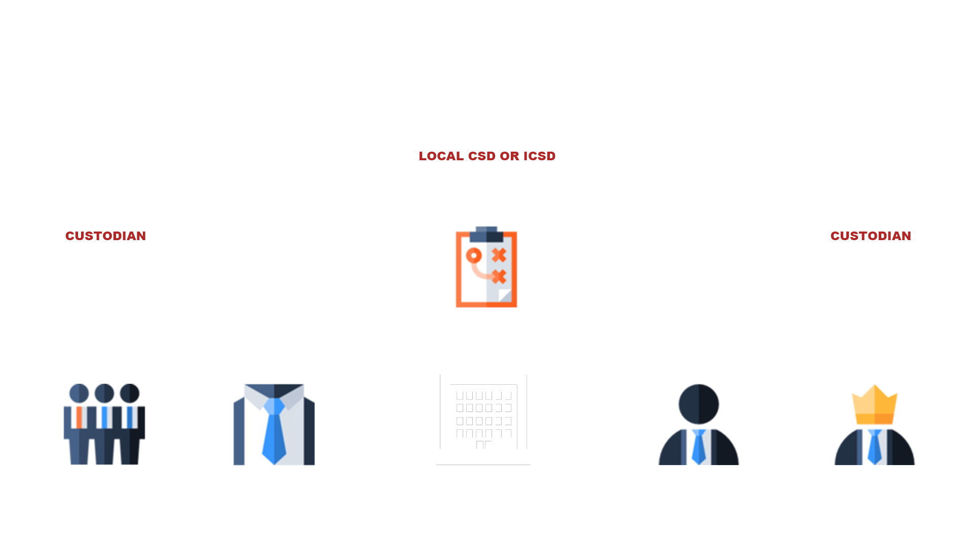
THE ESSENCE
CENTRALIZED
TRANSACTION PROCESSING AND SETTLEMENT
Administrative record keeping
A middleman brings additional cost to the trade
Settlement through CSDs and ICSDs
Our business is very likely to be changed by a new technology
Notes:
Current business model is centralized, this helps us to make a lot of money
But business like this is very likely to be changed by new tech: Blockchain

Slide 4
MEET BLOCKCHAIN

Slide 5


Blockchain
4TH BLOCK
GENESIS
BLOCK
MORE BLOCKS
Bitcoin - The first application of Blockchain
3RD BLOCK
2ND
BLOCK
“The Blockchain is an incorruptible digital ledger of economic transactions that can be programmed to record not just financial transactions but virtually everything of value.”
Don & Alex Tapscott, authors Blockchain Revolution (2016)
What is Blockchain Technology?
Notes:
As a core component of Bitcoin, blockchain decentralized ledger.
Successful to some extends

Slide 6
Someone who find the solution could bring revolution into the industry
FASTER
IMMATURITY
Reconciliation-free
The tech is in early stage
CHEAPER
Opportunity
&
Challenge
DE-CENTRALIZED
Cost saving for infrastructures
Nobody knows how
MORE EFFICIENT
CHALLENGING
P2P direct transaction
Current business is mature
A plan to get on the front foot: B-Chain
Notes:
Custody with blockchain: could be faster, chapter and more efficient.
But 1. immature tech 2. Centralized business model is stable
Someday, from centralized to decentralized. We got to be ready

Slide 7
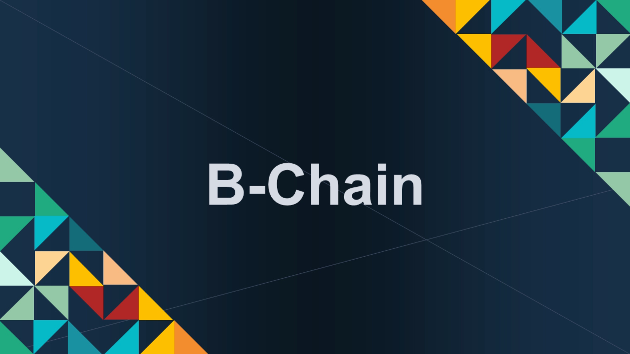
Notes:
Video

Slide 8
B
Advantages
Chain
Bank
Broker
Block
Fast settlement, away from reconciliation
Balance
B-Chain
Cost saving for infrastructures
Back Office
Transparency for regulators
Best
One-stop query platform
High trade volume
An innovative approach of using
Blockchain for Custody
To facilitate more deals

Slide 9
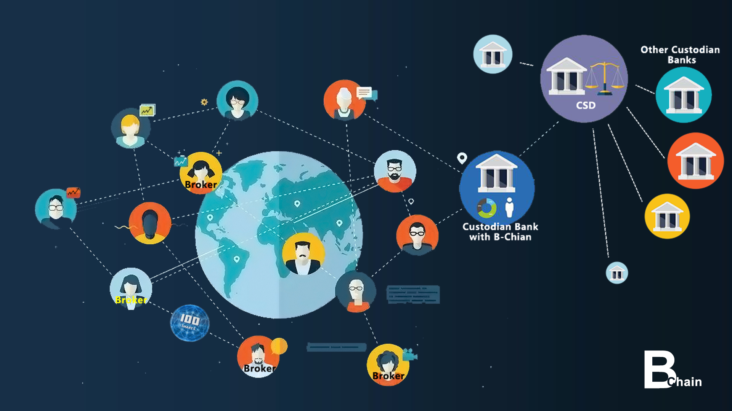
Q&A

Slide 10
THANKS
Drop us
a like !
Team B-Chain
Notes:
Last page of slide

